Slide 1
Data Science Training Trees, Bagging and Random Forest
Nov 7th 2016

Slide 2
Next sessions
Feb 8th - Trees in Optum business use case
Feb 15th - Deep Learning foundations (Dr. David Monagahan)
Feb 22nd - Convolutional Neural Nets (Dr. David Monaghan)
Mar 1st - Object Detection using DL
Mar 8th - Recurrent Neural Nets
Mar 15th - RNN in Optum business use case (Dr Kathrin Bujna) ???

Slide 3
Machine Learning
Today we expand on trees.
Trees is a non-parametric method, as opposed to regression, ridge, lasoo which are parametric methods. They assume a form to the data, trees do not assume any form, so is good for complex shapes.
Random forest is called an ensemble method. It creates a lot of different trees and averages the results.
It is rather unituintive, but true, that when you make lots of very silly trees, or weak learners, and add them together; it works better than combining strong trees. Today we learn how to make silly trees ☺ those weak learners.
Gradient Boosting is an ensemble method also. It generates lot of trees and each tree aims to fix the error of the previous tree. It uses weak trees for this also.
See the book on Box or free online An Introduction to Statistical Learning, with Applications in R. Gareth James, Daniela Witten, Trevor Hastie and Robert Tibshirani

Slide 4
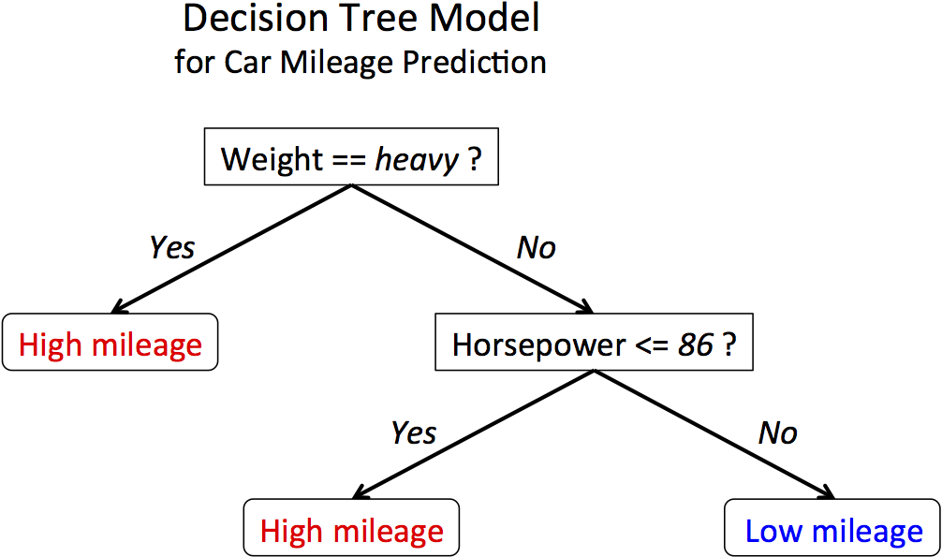
The basics

Slide 5
Ensemble of Weak Decision Trees
“Random Forest”
All Data Variables
Notes:
An ensemble of trees brings many weak learners together to make a stronger single learner.
So each one of these trees is very short, and it only uses a small subset of the variables.
Example….

Slide 6
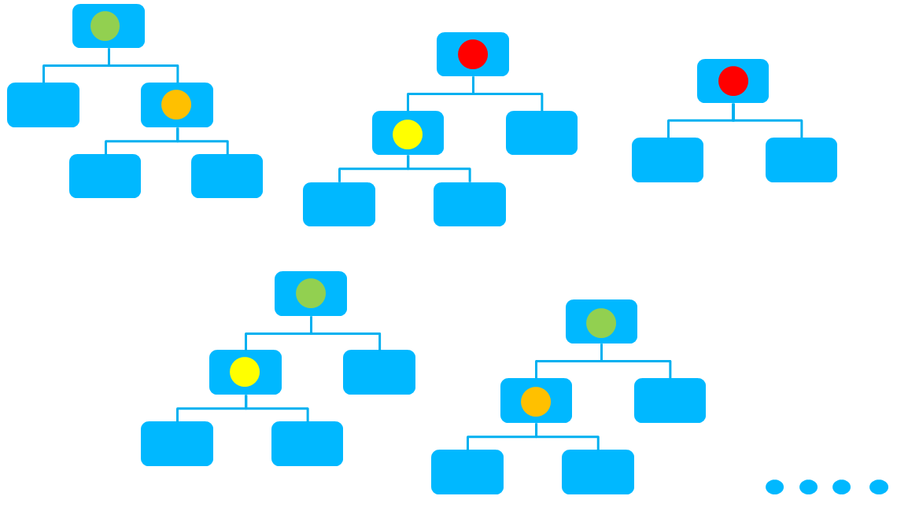
Ensemble of Weak Decision Trees
“Random Forest”
All Data Variables
Average prediction of all trees to make one prediction
Notes:
An ensemble of trees brings many weak learners together to make a stronger single learner.
So each one of these trees is very short, and it only uses a small subset of the variables.
Example….

Slide 7
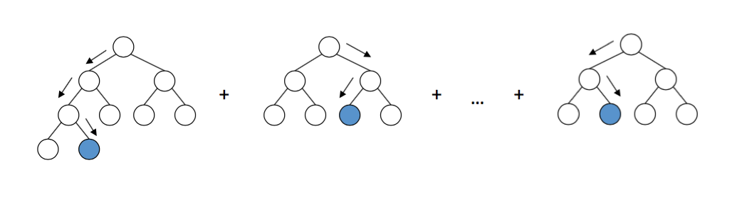

Gradient Boosting
Weak learners :
X_train
Y_act
Pass the error
Pass the error
Model1
Model 2
Pass the error
Model 3
Model 4
X_test
Predict y_pred1
Predict y_pred2
Predict y_pred3
…..
Predict y_predN
+
+
+
+
= y_pred

Slide 8
Gradient Boosting
Weak learners :
X_train
Predict y_out1
Predict y_out2
Predict y_outN
Y_act
1
0
0
1
0
0
0
1
Y_in1 | Y_out1
1 | 0.5
0 | 0.2
0 | 0.3
1 | 0.4
0 | 0.1
0 | 0.7
0 | 0.2
1 | 0.8
Y_in2 | Y_out2
0.5 | 0.4
-0.2 | 0.1
-0.3 | 0.4
0.6 | 0.7
-0.1 | 0.2
-0.7 | 0.6
-0.2 | 0.0
0.2 | 0.1
Y_in2 | Y_out2
0.01 | 0.1
-0.01 | 0.0
-0.01 | 0.0
0.01 | 0.1
0.01 | -0.1
-0.01 | -0.1
-0.02 | 0.0
0.01 | 0.1
Pass the error
Pass the error
X_test
Predict y_pred1
Predict y_pred2
…..
Predict y_predN
+
+
+
= y_pred

Slide 9
Gradient Boosting – Learning Rate
Learning Rate = 0.1
Predict y_out1
Predict y_out2
Predict y_out2
Predict y_outN
Y_act
1
0
0
1
0
0
0
1
Y_in1 | Y_out1
1 | …
0 | …
0 | …
1 | …
0 | …
0 | …
0 | …
1 | …
Y_in2 | Y_out2
… | …
… | …
… | …
… | …
… | …
… | …
… | …
… | …
Y_in2 | Y_out2
… | …
… | …
… | …
… | …
… | …
… | …
… | …
… | …
Y_in2 | Y_out2
… | …
… | …
… | …
… | …
… | …
… | …
… | …
… | …
Pass 0.9x error
Pass 0.81x error
Pass 0.72x error
Pass 0.03x error
X_test
Predict y_pred1
Predict y_pred2
Predict y_pred3
…..
Predict y_predN
+
+
+
+
= y_pred

